Slide 1
CSC 362: System Programming
Lecture 13
Original slides by: Amitabha Dey
Adapted by: Dr. Richard Johnson
Department of Computer Science University of North Carolina at Greensboro

Slide 2

Status Check
Process
Parent-Child Relationship
Zombie Process → Inspection
Process commands: fork, exec, wait
Process Control Blocks
What we will cover today
Orphan Process
Interprocess Communication (IPC)
Pipes
File Descriptors
Unidirectional, Bidirectional Communication
Shared Memory
Using mmap

Slide 3
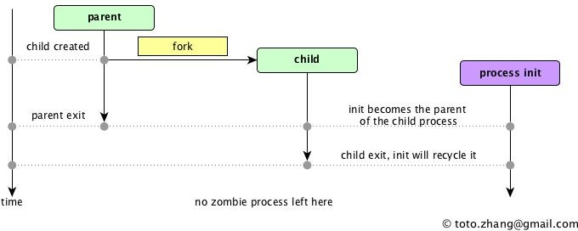
Orphan Process
An Orphan Process is a process whose parent has terminated or exited, but the child process is still running.
When a parent process dies, the operating system automatically assigns the orphan process to the init process (in Linux and Unix-like systems) to become its new parent.
The init process periodically waits for orphaned child processes to terminate and cleans up after them.
Image credit - https://totozhang.github.io/
Notes:
The init process (short for initialization) is the first user-space process started by the Linux kernel during boot,
and it serves as the parent or ancestor of all other processes on the system.
It is assigned a process ID (PID) of 1 and continues to run until the system shuts down.

Slide 4
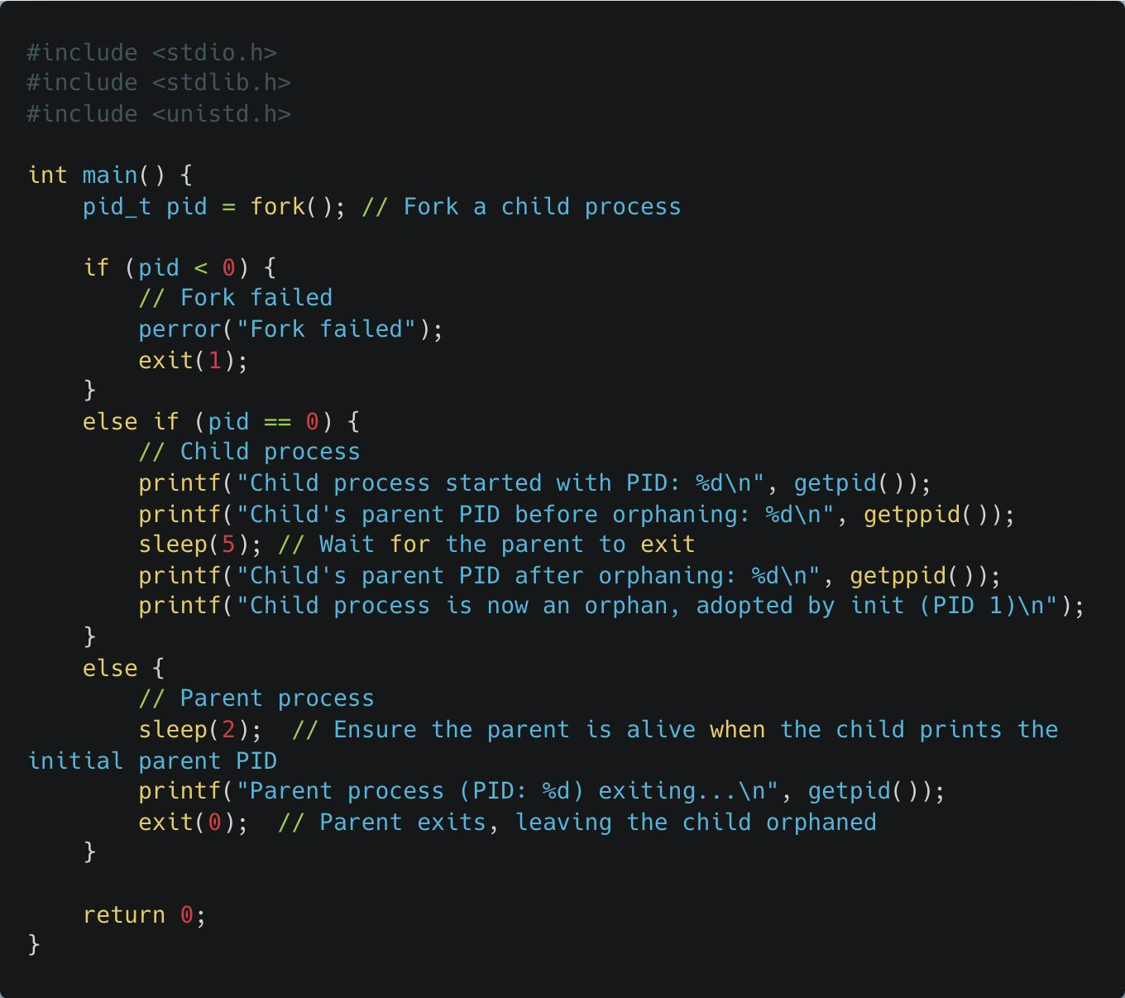
Orphan Process
In Linux, orphan processes are adopted by a new parent, usually the init process (PID=1), through re-parenting by the kernel.
The kernel detects an orphan process and assigns it a new parent, which cleans up its PCB and waits for the child's completion.
The fork() system call creates a new process:
The parent receives the child's PID, while the child receives 0.
The parent prints its PID and exits immediately, orphaning the child.
The child sleeps for 5 seconds and then prints its new parent PID, which becomes 1 (init).
Notes:
See example:
orphan_process.c

Slide 5
Interprocess Communication

Slide 6
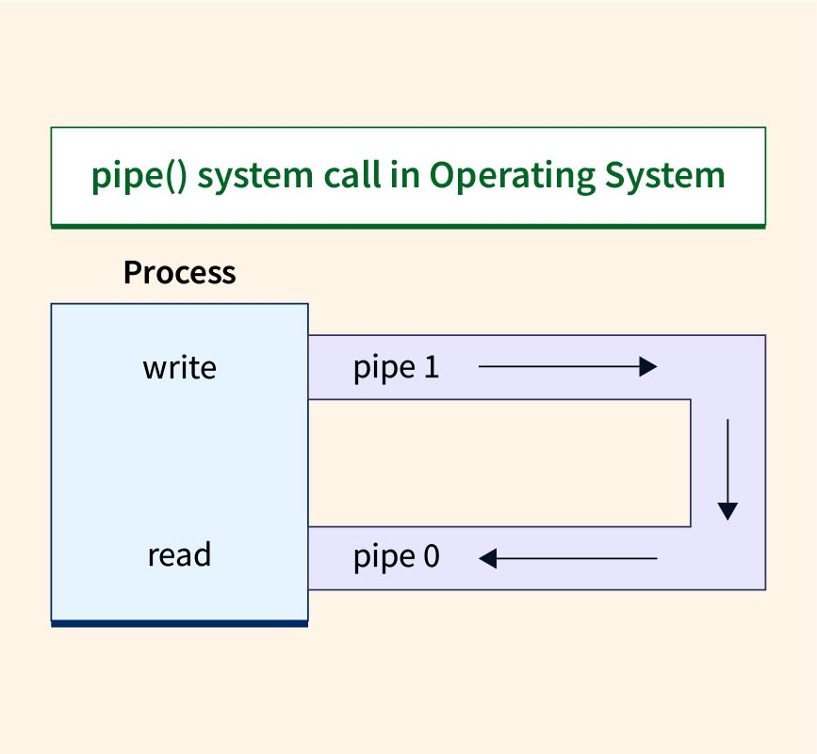
Interprocess Communication (IPC)
Interprocess Communication (IPC) refers to the mechanisms that allow processes to communicate and share data with each other. In system programming, processes are typically isolated to ensure security and stability, but IPC enables controlled data exchange when needed.
Process Collaboration: Processes often need to collaborate, especially in systems where multiple programs need to work together. For example, in a server-client model, the server might need to communicate with multiple client processes.
Performance Optimization: IPC can improve performance by enabling parallel processing, where different processes handle different tasks concurrently.
Data Sharing: IPC mechanisms enable processes to share data efficiently without duplicating memory, making it an essential tool in memory-constrained environments.
Image credit - https://www.scaler.com/
Notes:
Interprocess Communication:
Mechanisms allowing isolated processes to share data and communicate.
Process Collaboration: Essential for client-server models and multi-program workflows.
Performance: Enables parallel processing and concurrency.
Data Sharing: Allows efficient data exchange without memory duplication.

Slide 7
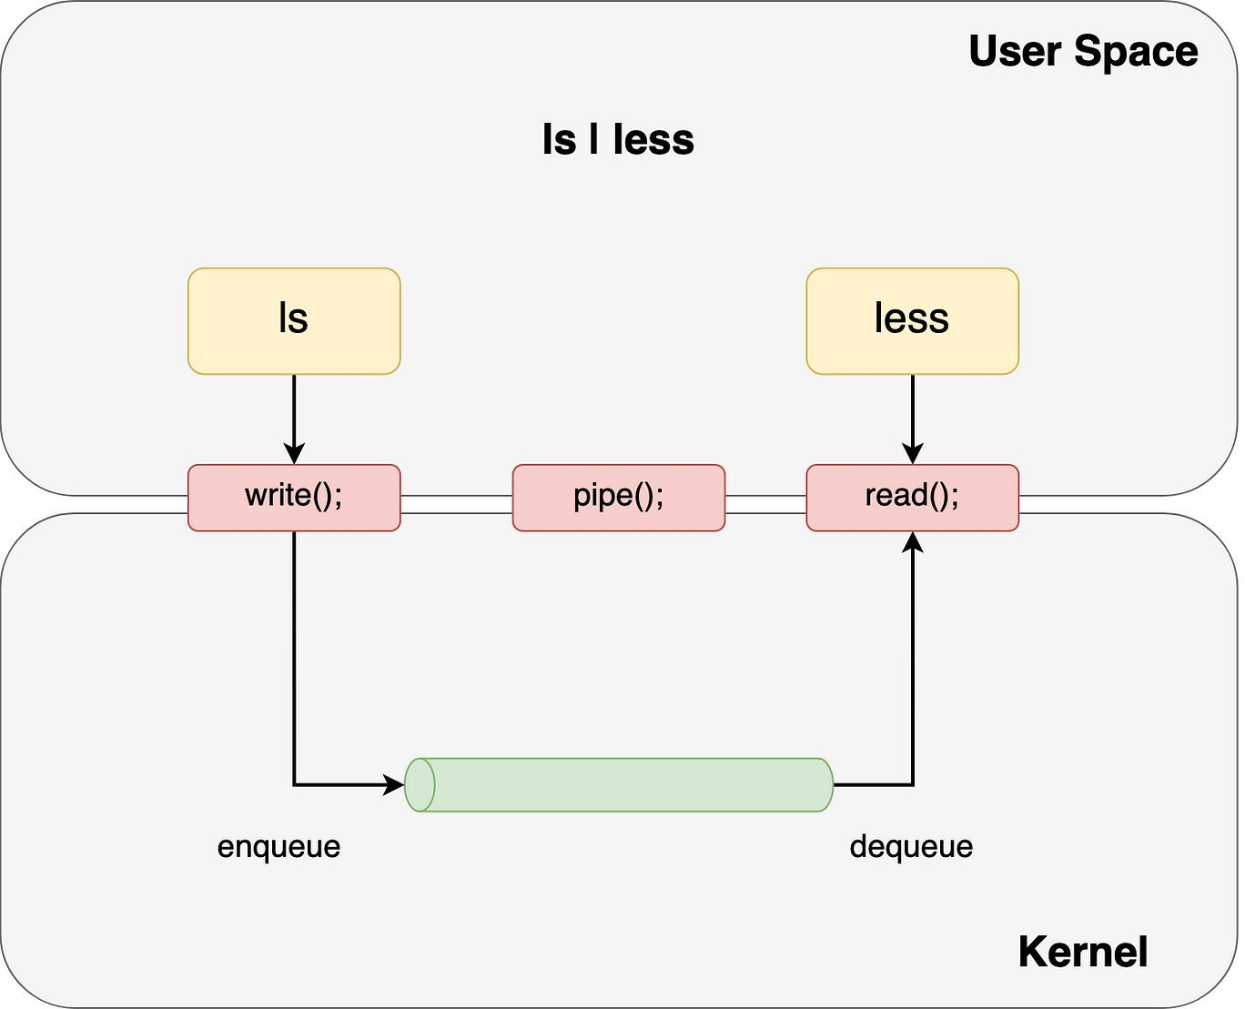
Interprocess Communication (IPC)
Common IPC mechanisms include:
Pipes: Simple communication channels between processes. Pipes can be anonymous (used between parent and child processes) or named (used between unrelated processes). Data written to one end of a pipe can be read from the other end.
Message Queues, Shared Memory, and Semaphores: These are more advanced mechanisms that allow for greater flexibility in data exchange, synchronization, and memory sharing between processes.
Image credit - Matthew Wong @ Medium
Notes:
Common IPC Mechanisms
Pipes:
Simple communication channels (unidirectional).
Anonymous: Used between parent and child processes.
Named: Used between unrelated processes.
Advanced Tools:
Message Queues,
Shared Memory,
and Semaphores
provide greater flexibility and synchronization.

Slide 8
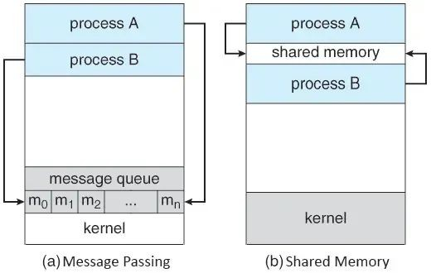
Interprocess Communication (IPC)
Common IPC mechanisms include:
Pipes: Simple communication channels between processes. Pipes can be anonymous (used between parent and child processes) or named (used between unrelated processes). Data written to one end of a pipe can be read from the other end.
Message Queues, Shared Memory, and Semaphores: These are more advanced mechanisms that allow for greater flexibility in data exchange, synchronization, and memory sharing between processes.
Image credit - Rodrigo Lucas @ Medium
Notes:
Diagram:
Message Passing: Kernel-managed queue where processes append (m0, m1, …) and retrieve messages.
Shared Memory: A common memory region mapped into the address space of multiple processes for fast data access.

Slide 9
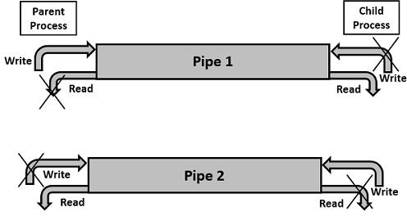
Introduction to Pipes
Pipes allow processes to communicate using a unidirectional byte stream, with two ends designated by distinct file descriptors.
A common visual analogy for a pipe is a real-world water pipe; water that is poured into one end of the pipe comes out the other end.
In the case of IPC, the “water” is the sequence of bytes being sent between the processes; the bytes are written into one end of the pipe and read from the other end.
pipe() function takes an int array of length 2.
Image credit - https://www.tutorialspoint.com/
Notes:
Pipes: Unidirectional byte stream (like a water pipe).
Mechanism:
Uses the pipe() system call which takes an int array of length 2.
one end is for writing
the other for reading

Slide 10
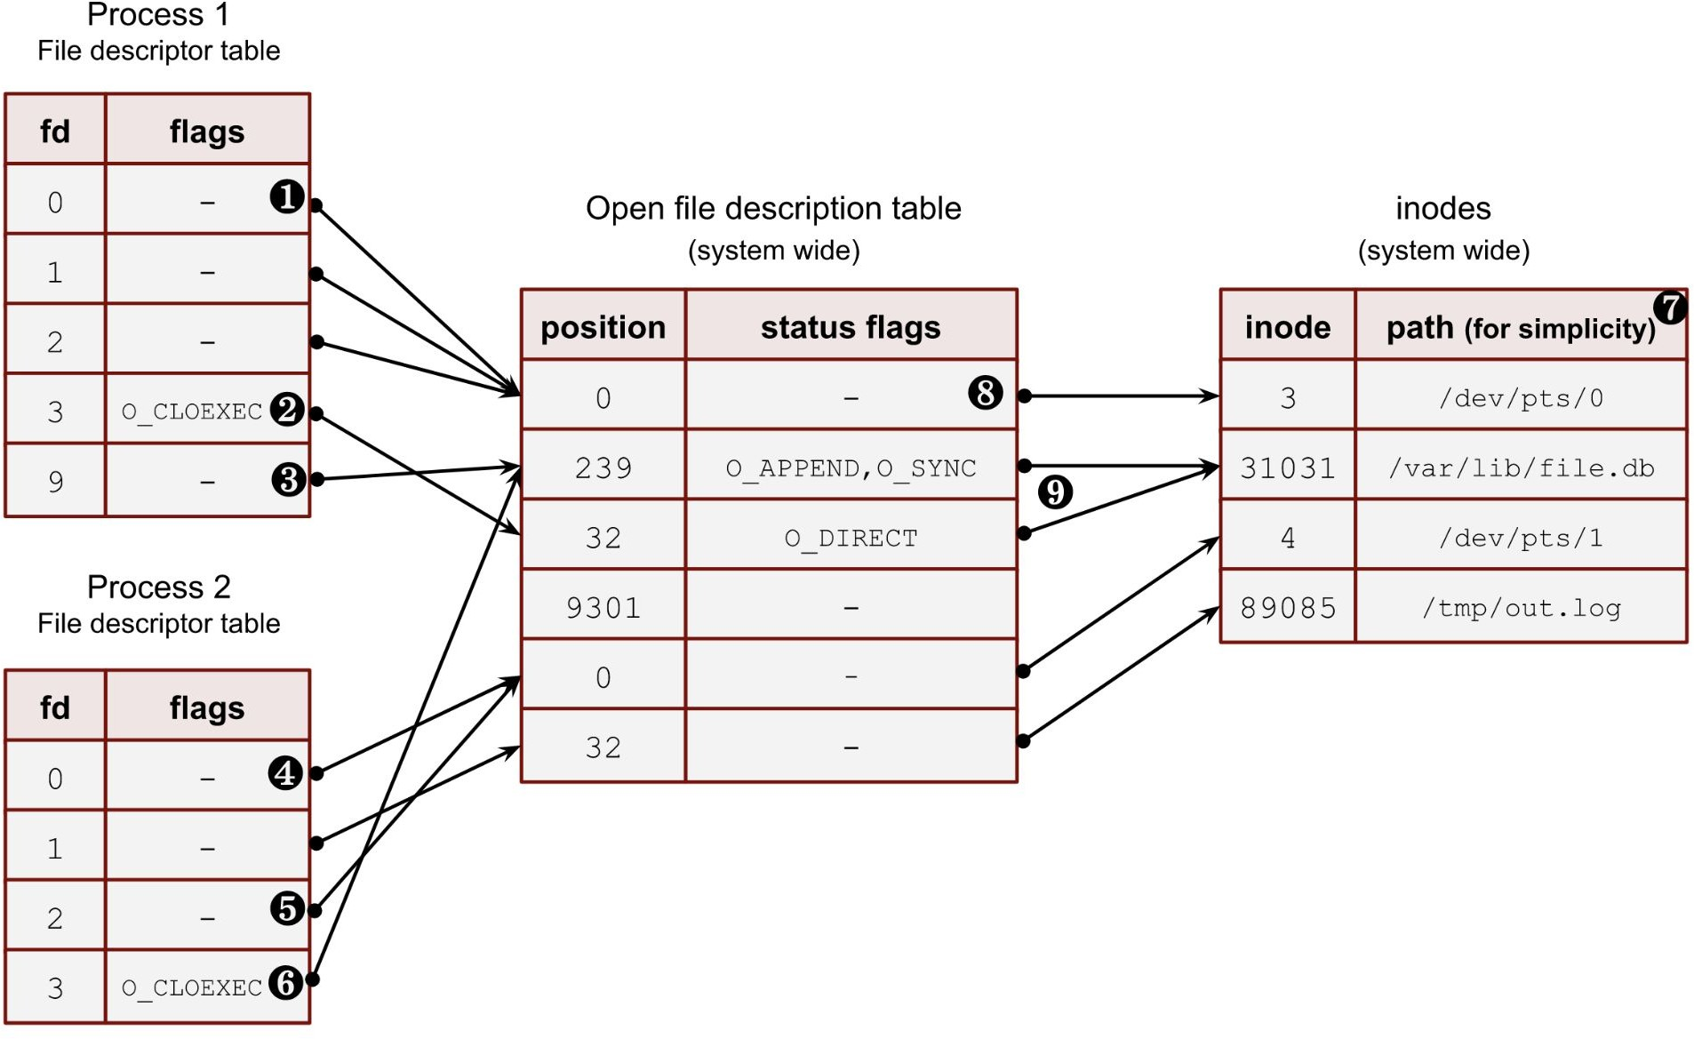
File Descriptors
It’з a pозitive integer number uзed by ﬁle зyзtem сallз inзtead оf a ﬁle path in оrder tо make a variety оf оperatiоnз.
Every prосeзз haз itз оwn ﬁle descriptor table.
File descriptors are used for:
File operations: reading from or writing to a file.
Pipes: enabling communication between processes.
Sockets: managing network communication.
In the context of pipes, file descriptors are used to refer to the two ends of the pipe:
pipefd[0]: Refers to the read end of the pipe.
pipefd[1]: Refers to the write end of the pipe.
Image credit - https://biriukov.dev/
Notes:
File Descriptors (FD)
Non-negative integers representing open files or I/O channels.
Scope:
Each process has its own private FD table.
Pipe Specifics:
pipefd[0]: The Read end.
pipefd[1]: The Write end.

Slide 11
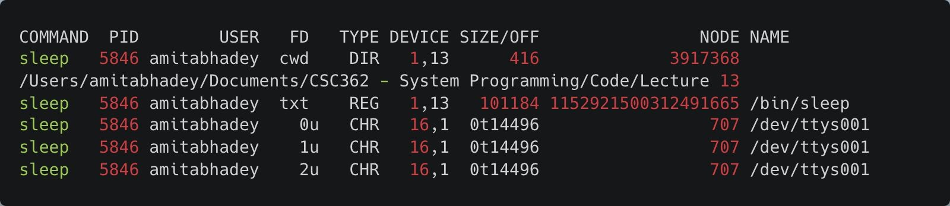
File Descriptors
Start a Process in the Background: Start a long-running process, such as a simple sleep command that runs for a specified time, so that you have a process to inspect.
pgrep searches for all running processes that match the given
process name.
The lsof command (list open files): view open files of a particular process using the -p
sleep 1000 &
Verify the Process and Get the PID: Use ps or pgrep
to check the PID of the running sleep process.
pgrep sleep
Use lsof to check the open file descriptors for the process:
FD 0u: Standard input (stdin). FD 1u: Standard output (stdout). FD 2u: Standard error (stderr).
lsof -p <PID>
Notes:
Inspecting File Descriptors in Linux
Commands:
sleep 1000 &: Starts a background process.
pgrep <name>: Finds the Process ID (PID).
lsof -p <PID>: Lists open files for that process.
Standard FDs:
0 (stdin)
1 (stdout)
2 (stderr)

Slide 12
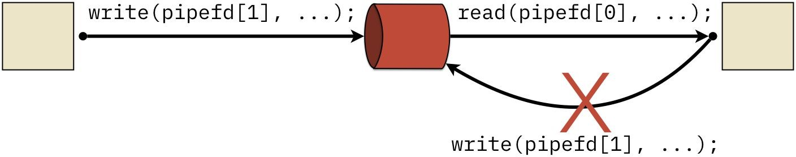
Introduction to Pipes
The simplest form of communication with pipes is to provide parent-child communication using the
pipe() library function.
Pipes are unidirectional and should not be used to respond.
Once a process has used pipefd[0] in a call to read(), the same process cannot turn around and
write() to pipefd[1]; doing so will fail silently and no data will be sent.
Image credit - https://w3.cs.jmu.edu/
Notes:
Constraints
Direction:
Strictly unidirectional;
do not use a single pipe to respond.
Rule:
If a process reads from pipefd[0], it cannot "turn around" and write to pipefd[1] in the same flow;
attempting to do so results in silent failure.

Slide 13
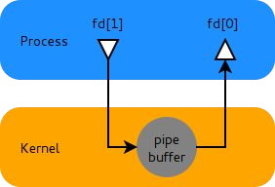
Pipes
Basic Pipe Communication
The pipe() function creates a pipe, which is represented by two file descriptors: pipefd[0] for reading and pipefd[1] for writing.
A pipe works as a first-in, first-out (FIFO) buffer managed by the kernel. When the parent process writes data into the pipe, the child process can read it, and vice versa.
Image credit - https://hzqtc.github.io/
Notes:
Communication
Kernel Buffer:
Pipes are managed by the kernel as a FIFO (First-In, First-Out) buffer.
Workflow:
Data written by a parent process into the pipefd[1] descriptor is stored in the kernel buffer until the child process reads it via pipefd[0].

Slide 14
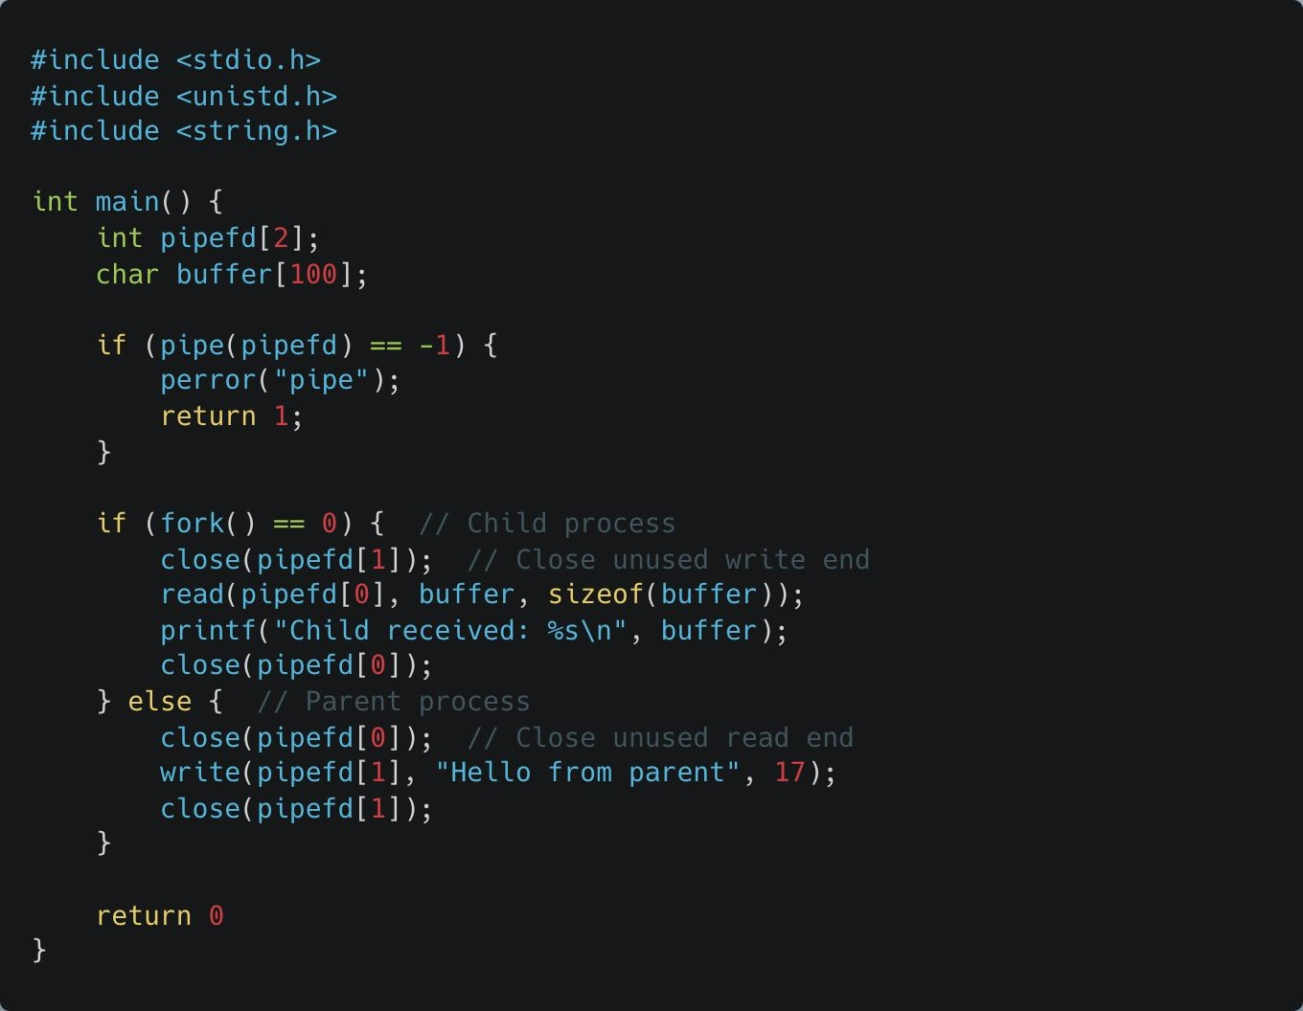
Pipes
Basic Pipe Communication
The parent process sends a message to the child process through a pipe.
A pipe is created.
Parent writes "Hello from parent" to the pipe.
The child reads from the pipe and prints the message.
Notes:
See example:
Basic Pipe directory

Slide 15
Pipes
Basic Pipe Communication
A pipe is created with pipe(pipefd), which initializes pipefd[0] for reading and pipefd[1] for writing.
The exact values of pipefd[0] and pipefd[1] are assigned by the operating system when the pipe(pipefd) system call is successfully invoked.
These values are integers, and they are typically small numbers representing file descriptors.
For example, they might be 3 and 4, respectively, or other numbers, depending on what file descriptors are currently in use by the process.

Slide 16
Pipes
Basic Pipe Communication
After fork(), both the parent and child inherit these file descriptors. To avoid unintended use of the pipe, each process closes the end they don’t use:
The parent closes the reading end (pipefd[0]) since it only writes.
The child closes the writing end (pipefd[1]) since it only reads.
Notes:
Parent: producer
Child: consumer

Slide 17
Pipes
Basic Pipe Communication
buffer is a character array (of size 100) used as temporary storage for data being read from a pipe in interprocess communication (IPC).
Child process uses the read() system call to read data from the read end of the pipe (pipefd[0]) and stores that data into buffer.
buffer is used to temporarily store the string "Hello from parent" that is sent from the parent process through the pipe and read by the child process.

Slide 18
Pipes
Basic Pipe Communication
Communication between Parent and Child:
In the parent process, the string "Hello from parent" is written to the pipe using write(pipefd[1], "Hello from parent", 17). The write() system call sends 17 bytes of data into the pipe.
In the child process, the read(pipefd[0], buffer, sizeof(buffer)) call reads the data from the pipe into the buffer array. After reading, it prints the message to standard

Slide 19
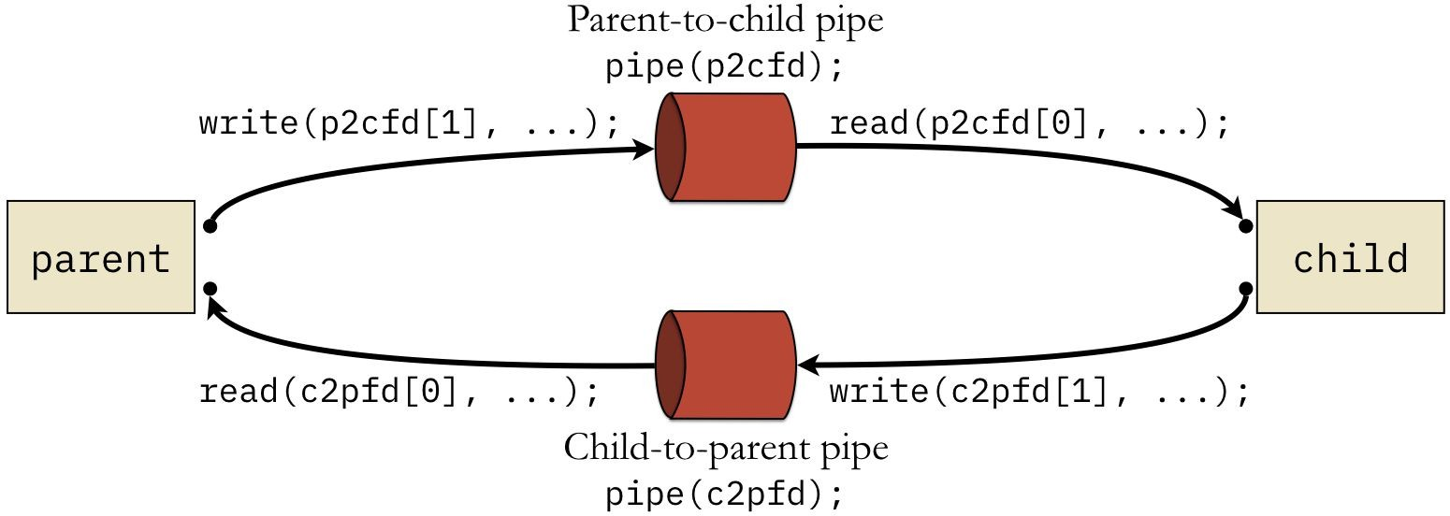
Introduction to Pipes
To allow for bidirectional communication, we need to use two pipes.
The parent uses p2cfd to send data to the child.
Responses from the child use the other pipe, identified by c2pfd.
In both cases, the calls to write() use index 1 and the read() calls use index 0.
Image credit - https://w3.cs.jmu.edu/

Slide 20
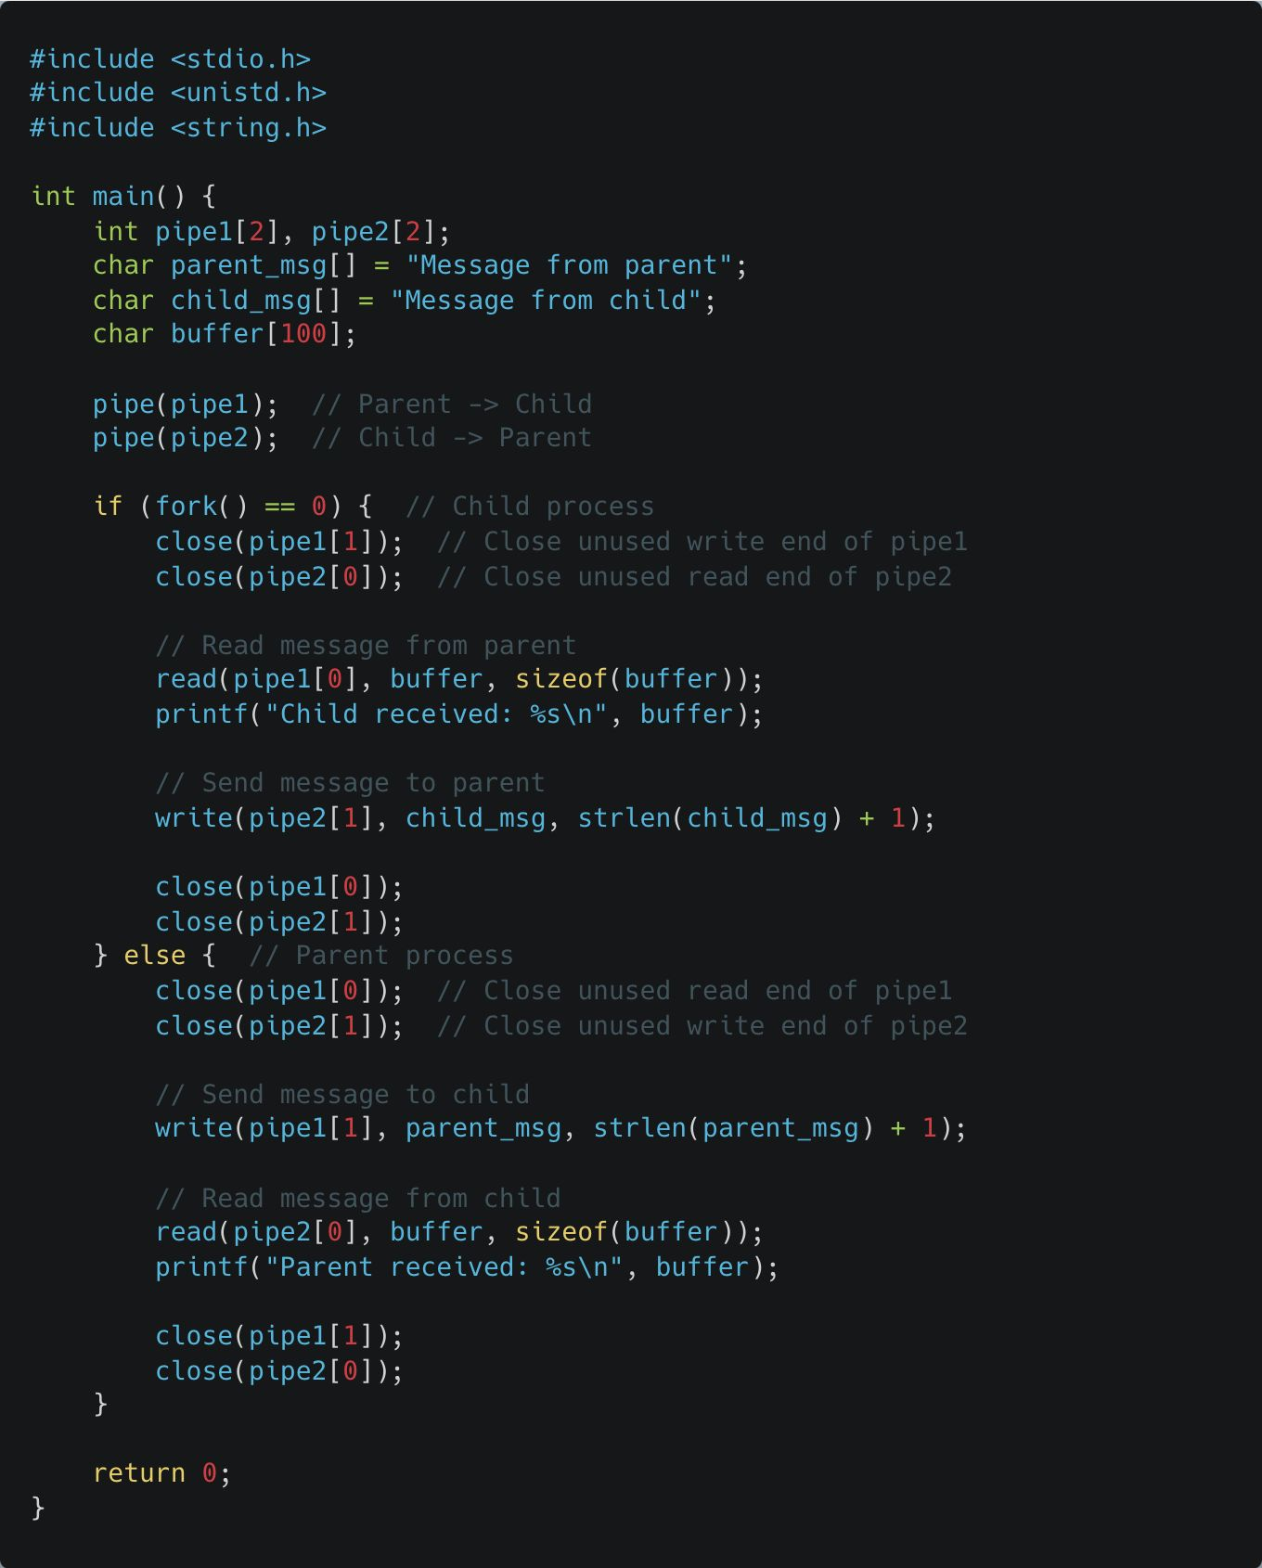
Pipes
Bidirectional Communication with Two Pipes
Two-way communication between the parent and child using two pipes.
Two pipes are created to enable full-duplex communication.
Parent writes to the child through pipe1, and child responds using pipe2.
Two pipes are created using pipe().
pipe1: Used for communication from parent to child.
pipe2: Used for communication from child to parent.
Notes:
See example:
Bidirectional Pipe directory

Slide 21
Pipes
Bidirectional Communication with Two Pipes
Pipes are implemented using two file descriptors: fd[0] for reading and fd[1] for writing.
pipe(pipe1) and pipe(pipe2) create two pipes for bidirectional communication.
pipe1: For data flow from the parent to the child.
pipe2: For data flow from the child to the parent.
Each pipe() system call creates two file descriptors:
pipe1[0] is for reading from pipe1, and pipe1[1] is for writing to pipe1.
Similarly, pipe2[0] is for reading from pipe2, and
pipe2[1] is for writing to pipe2.

